Slide 1
Introduction
It is widely used general purpose,high level programming language.Developed by Guido van Rossum in 1991.
It is used for:
software development,
web development (server-side), system scripting,
Mathematics.

Slide 2
Features of Python
Easy to use – Due to simple syntax rule
Interpreted language – Code execution & interpretation line by line
Cross-platform language – It can run on windows,linux,macinetosh etc. equally
Expressive language – Less code to be written as it itself express the purpose of the code.
Completeness – Support wide rage of library
Free & Open Source – Can be downloaded freely and source code can be modify for improvement

Slide 3
Shortcomings of Python
Lesser libraries – as compared to other programming languages like c++,java,.net
Slow language – as it is interpreted languages,it executes the program slowly.
Weak on Type-binding – It not pin point on use of a single variable for different data type.

Slide 4
Installing Python
Two Steps Only –
Download Python distribution
Python installation process

Slide 5
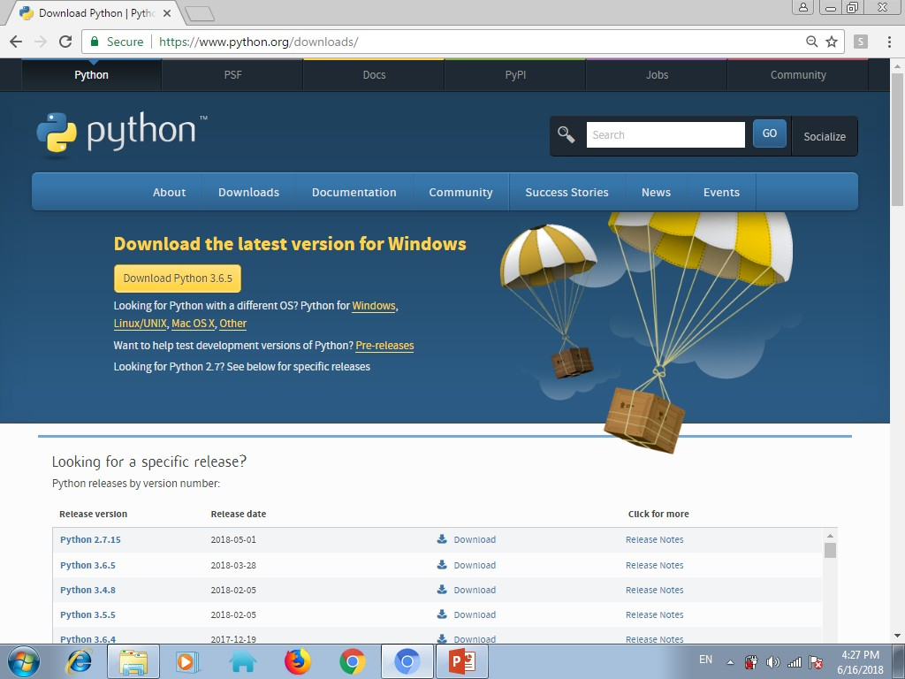
Installing Python
1. Download Python distribution
You can download python distribution from the link given below
https://www.python.org/downloads/
Note – Download only that python distribution/MSI Installer, which is best suited for the Operating system on which you want to install it.

Slide 6
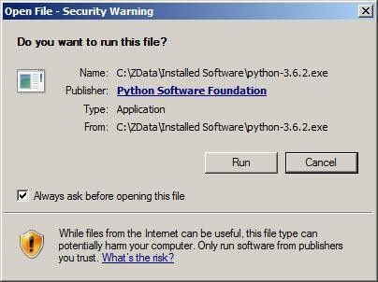
Installing Python
2. Python installation process
1. Double-click the icon labeling the file <version>.exe
Popup window will appear
Click on Run option

Slide 7
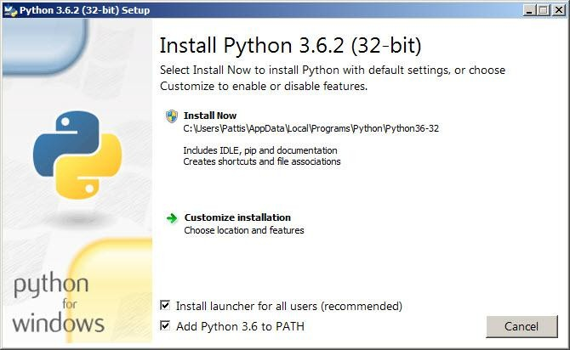
Installing Python
2. Setup popup window will appear
If the Python Installer finds an earlier version of Python installed on your computer, the Install Now message will instead appear as Upgrade Now(and the checkboxes will not appear).
Highlight the Install Now (or Upgrade Now) message, and then click it

Slide 8
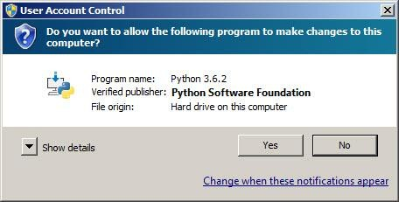
Installing Python
3. User Account Conrol pop-up window will appear
Click the Yes button.

Slide 9
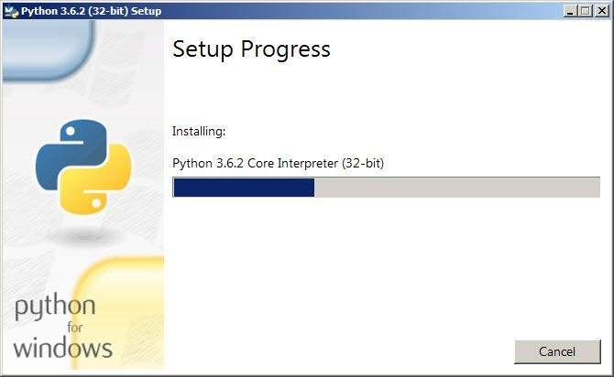
Installing Python
4. A new Python <version> Setup pop-up window will appear with a Setup
Progress message and a progress bar.

Slide 10
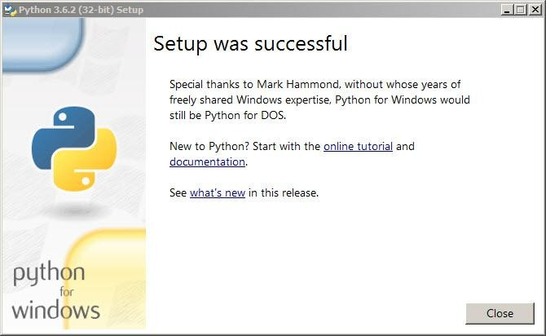
Installing Python
5. Soon, a new Python <version> Setup pop-up window will appear with
a Setup was successfully message
Click the close button

Slide 11
How to work in Python
After installation of python ,we can work on it in following ways
in Interactive mode
in Script mode

Slide 12
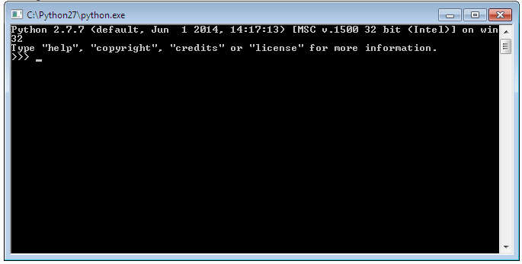
How to work in Python
(i) in Interactive mode
* Search the python.exe file in the drive in which it is installed.
If found double click it to start python in
interactive mode

Slide 13
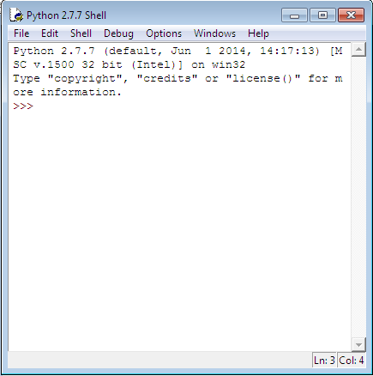
How to work in Python
* Click start button -> All programs -> python<version>->IDLE(Python GUI)

Slide 14
How to work in Python
Python command prompt >>>
Type the following at prompt print “hello”
print 8*3 print 3**3 k=3+4*3
print k

Slide 15
How to work in Python
(ii) in Script mode
Step 1 (Create program file)
Below steps are for simple hello world program
Click Start button->All Programs ->
Python<version>->IDLE
Now click File->New in IDLE Python Shell Now type
print “hello” print “world”
print “python is”,”object oriented programming lang.”
Click File->Save and then save the file with filename and .py extension

Slide 16
How to work in Python
(ii) in Script mode
Step 2 (Run program file)
Click Open command from IDLE’s File menu and select the file you have already saved
Click Run-> Run Module
It will execute all the commands of program file and display output in separate python shell window
Note :- Python comes in 2 flavours – python 2.x and python 3.x . Later one is Backward incompatible language as decide by Python Software foundation(PSF). Mean code written in 2.x will not execute on 3.x . Visit the below link for difference between 2.x & 3.x
https://www.geeksforgeeks.org/important-differences-between-python-
2-x-and-python-3-x-with-examples/

